Slide 1
Profiling Non ARM-Instrumented Applications via TPTP
Yoonki Song
Last Updated: 10/8/2009

Slide 2
Prerequisites
Part II

Slide 3
Prerequisites
Server Side
WebSphere Application Server (WSAS) v6.1 Setup
Refer to “PerfTest – Setup (WSAS).pptx”
TPTP Standalone Agent v4.5.1 Setup
Refer to “PerfTest –Setup (TPTP).ppt”
Client Side
TPTP all-in-one v4.5.1 Setup
Refer to “PerfTest – Setup (TPTP).pptx”

Slide 4

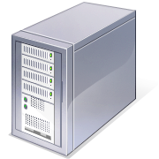
Environment for non-ARM Instrumentation
Client:
My laptop (Dynamic IP)
Java v1.5 or lower
TPTP all-in-one v4.5.1
Server:
eb2-2241-grd02.csc.ncsu.edu (152.14.90.8)
Java v1.5 or lower
WebSphere Application Server v6.1
TPTP Standalone Agent Controller v4.5.1

Slide 5

Sequence for Collecting Trace data with non-ARM Instrumentation(TPTP)
Client
Server
startWSAS.bat
Start TPTP Agent Controller (TPTP-AC)
Start WebSphere Application Server (WSAS)
3. Use TPTP to collect trace data
4. Our plug-in analyzes trace data (B)
Trace data (B)

Slide 6
Profile Configuration on TPTP

Slide 7
…
Screenshots will be here

Slide 8
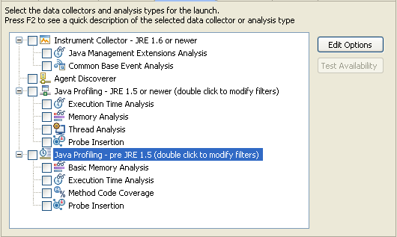

Slide 9
Start the Plant web application (AppSrv02, 9083, 9063)
Setup the environment for RPT profiling
Create a performance test suite for the Plant web application.
Run the performance test suite by RPT while collecting profiling data by RPT. The profiling data is stored in a local trcxml file (t1_rpt.trcxml)
Restart the Plant web application (after uninstrumentation)
Setup the environment for TPTP profiling
Run the performance test suite by RPT while collecting profiling data by TPTP. The profiling data is stored in a local trcxml file (t1_tptp.trcxml)
Compare t1_rpt.trcxml and t1_tptp.trcxml to figure out the difference.

Slide 10
Trouble Shooting

Slide 11
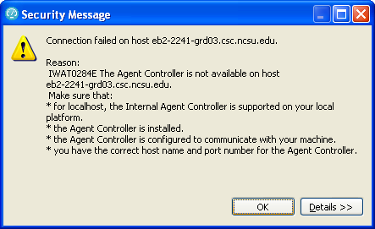
IWAT0284E
IWAT0284E

Slide 12
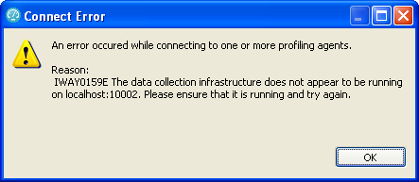
IWAY0159E

Slide 13
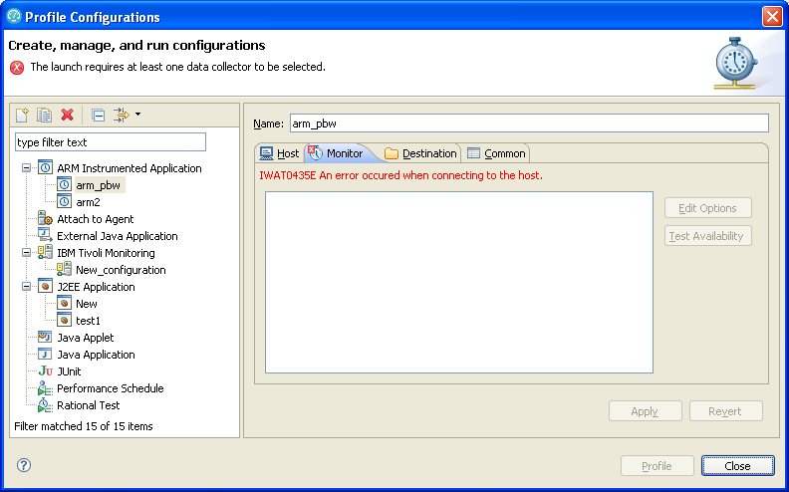
IWAT0435E

Slide 14
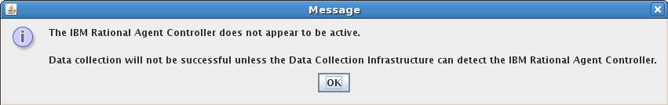
Trouble Shooting

Slide 15
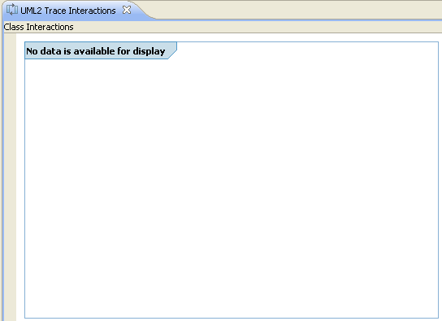
No data available for display
No data available for display

Slide 16
Hang “Connecting to the JVMPI agent”
My guess is that JVMTI (1.6) cannot deal with multi-threaded applications

Slide 17
References
Install WebSphere Application Server V6.0 for Linux on POWER (http://www.ibm.com/developerworks/systems/library/es-webapp/index.html)
WebSphere Application Server 6.1 Headless Install (http://bishop.camp.clarkson.edu/wiki/en/WebSphere_Application_Server_6.1_Headless_Install)

Slide 18
References
Using IBM Rational Performance Tester: Application Monitoring Part 1, Configuring your environment (http://www.ibm.com/developerworks/rational/library/07/0515_patel/index.html)
Using IBM Rational Performance Tester: Application Monitoring Part 2, Enabling real-time monitoring (http://www.ibm.com/developerworks/rational/library/07/0515_patel2/index.html)
Using IBM Rational Performance Tester: Application monitoring, Part 3: Importing data from IBM Tivoli database products (http://www.ibm.com/developerworks/rational/library/07/0605_patel/index.html)

Slide 19
Additional Slides

Slide 20
.bashrc on Linux
# “PerftTest(ARM)” project
# “PerftTest(TPTP)” project
export TPTP_AC_HOME=/opt/TPTP
export JAVA_PROFILER_HOME=$TPTP_AC_HOME/plugins/org.eclipse.tptp.javaprofiler
export PATH=$TPTP_AC_HOME/bin:$JAVA_PROFILER_HOME
export LD_LIBRARY_HOME=$LD_LIBRARY_HOME:

Slide 21
Workaround: Converting ARM-instrumented to TPTP Environment
Client
Server
Check if WSAS is running
If not, start WSAS
Un-instrumentation
Reboot the server

Slide 22
Start the Plant web application (AppSrv02, 9083, 9063)
Setup the environment for RPT profiling
Create a performance test suite for the Plant web application.
Run the performance test suite by RPT while collecting profiling data by RPT. The profiling data is stored in a local trcxml file (t1_rpt.trcxml)
Restart the Plant web application (after uninstrumentation)
Setup the environment for TPTP profiling
Run the performance test suite by RPT while collecting profiling data by TPTP. The profiling data is stored in a local trcxml file (t1_tptp.trcxml)
Compare t1_rpt.trcxml and t1_tptp.trcxml to figure out the difference.

Slide 23
References
Creating Custom Profilers with Probekit (http://www.eclipse.org/tptp/platform/documents/probekit/probekit_4.3.html)

Slide 24
Experiment

Slide 25
For each experiment
Restart (Stop & Start) WSAS

Slide 26
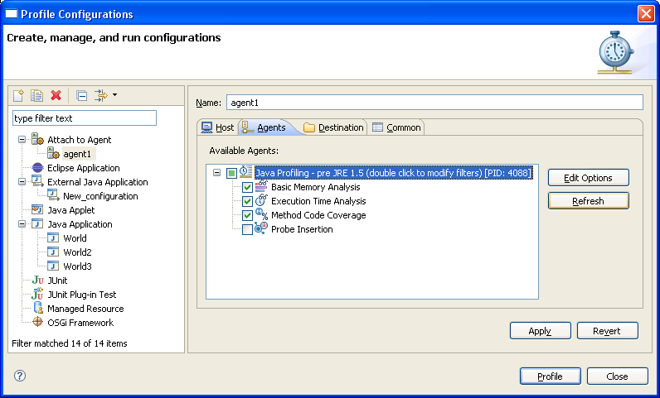
Profile Configuration
Heap
?
?

Slide 27
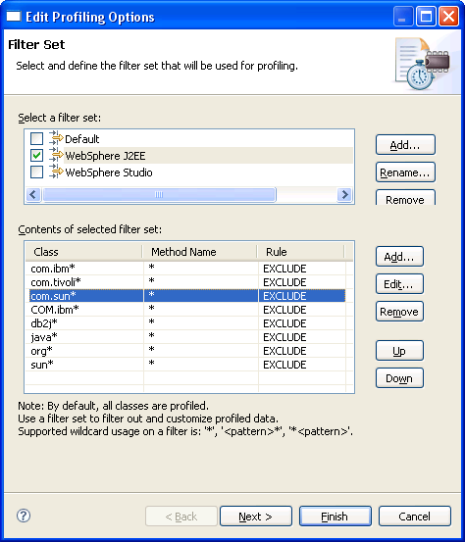
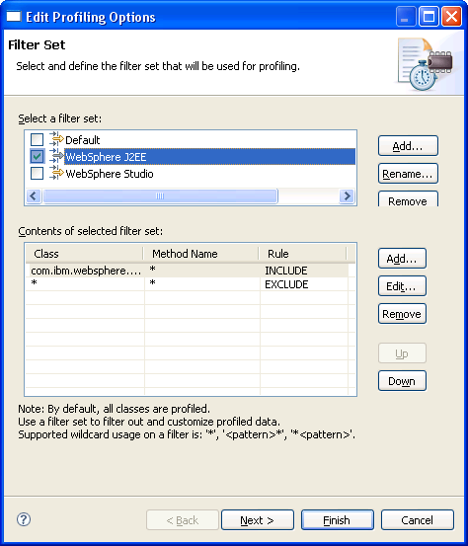
Profiling Options: Filter Set
Default
Customized

Slide 28
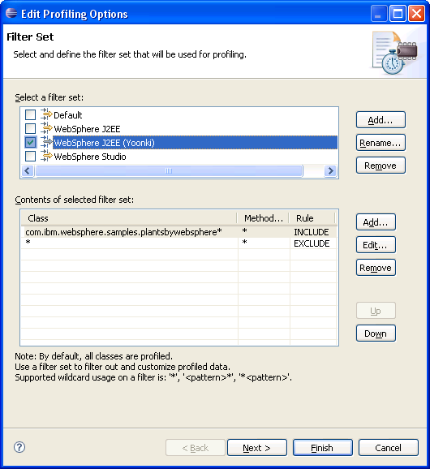
Seems to be good!!

Slide 29
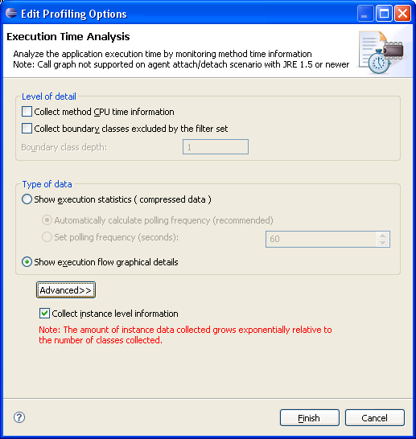
Profiling Options: Execution Time Analysis

